Slide 1

Moving object detection and tracking in a video by using computer-vision technique
Instructor: Dr. Dapeng Wu
Vikram Narre
University of Florida
Department of Electrical and Computer Engineering
EEE 6512: Image Processing and Computer Vision

Slide 2
OVERVIEW
1. Introduction
2. Applications of Object tracking
3. Object detection
4. Steps in Object tracking
5. Object tracking algorithm
6. pros and cons
7. Conclusion

Slide 3
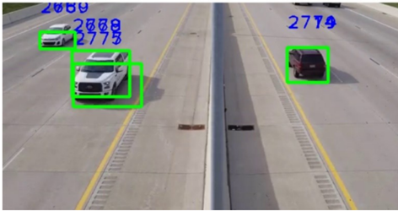
Introduction
The project describe the object tracking in a video.
The video in this project taken from Youtube.
The output in the project shows the object detection and tracking.

Slide 4
Applications of object tracking
Traffic Information.
Surveillance system
Human-computer interaction
Digital forensics
Augmented reality

Slide 5
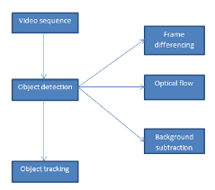
Schematic representation of object tracking system
https://www.google.com/url?sa=i&url=https%3A%2F%2Fwww.researchgate.net%2Ffigure%2FBasic-block-diagram-of-detection-and-Tracking-Fig-1-shows-the-basic-block-diagram-of_fig1_331421347&psig=AOvVaw24C3yPVZWdPyKjuTK-0hy7&ust=1639607423356000&source=images&cd=vfe&ved=0CAsQjRxqFwoTCJi8iIus5PQCFQAAAAAdAAAAABAD

Slide 6
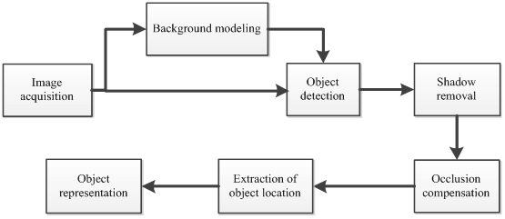
Object detection
Every tracking method requires an object detection mechanism either every frame or when object first appears in the video.
Challenges of moving object detection:
Information loss caused by the 3D world on a 2D image.
Image Noise
Complex object motion
Non-rigid or articulated nature of objects
Full or partial object occlusions
Complex object shapes
Image illumination changes
https://www.researchgate.net/profile/Yasir-Ali-11/publication/308694385/figure/fig10/AS:428262636691463@1479117177206/Figure-31-Flow-diagram-of-moving-object-detection.png

Slide 7
Segmentation
Segmentation is the process of identifying components of the image segmentation involves operations such as boundary detection connected components labeling, thresholding etc. Boundary detection find out the edges in the image. Thresholding is the process of the gray level in the image

Slide 8
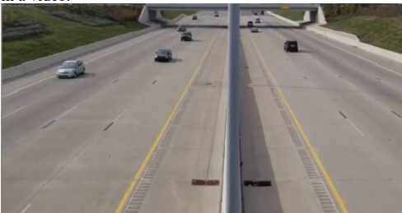
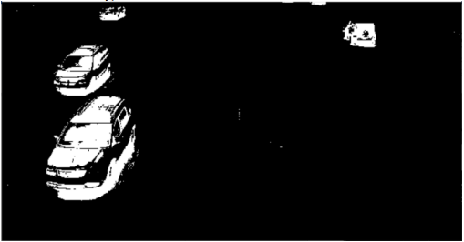
Background Subtraction
This is the process of separating the image's foreground and background. It is presumed in this case that the object of interest is in the foreground.
Raw image
Background subtracted image

Slide 9
Steps in Object Tracking
Segmentation
Background subtraction
Useful feature extraction and calculation
Tracking

Slide 10
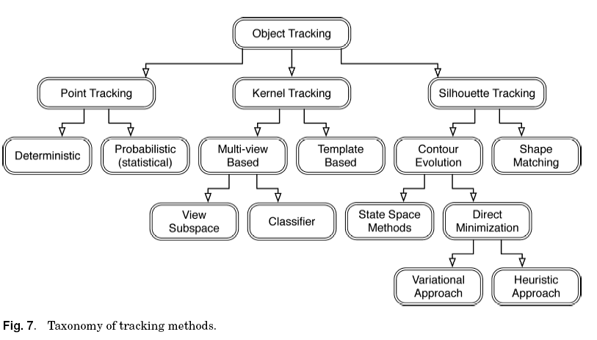

Slide 11
Camera Modeling
The camera model is a critical component of any object-tracking system. All existing object tracking systems rely on a current camera type. In other words, the camera model is derived directly from domain knowledge.
1. Single fixed camera
Example : Road traffic tracking system
2. Multiple fixed cameras
Example: Surveillance system
3. Single moving camera
Example: Animation and video compressing system
4. Multiple moving cameras
Example: Robot navigation system

Slide 12

Object Tracking Algorithm

Slide 13
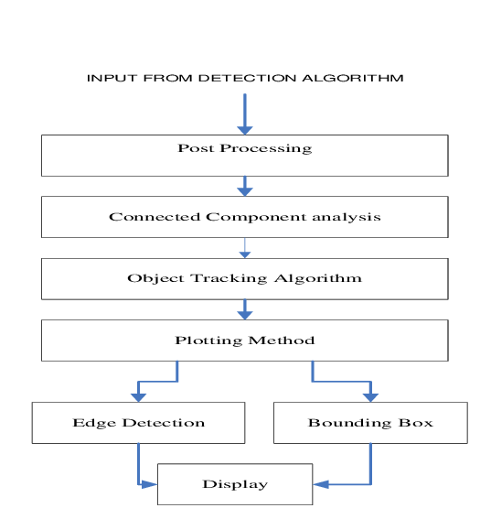
https://www.researchgate.net/profile/Habib-Mohammed-2/publication/325735814/figure/fig2/AS:636985098137605@1528880490967/Block-Diagram-for-Object-tracking-system.png

Slide 14
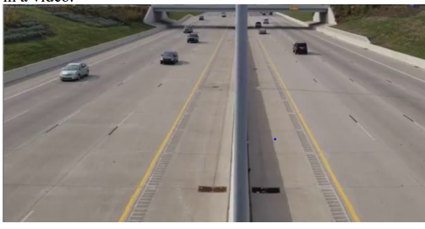
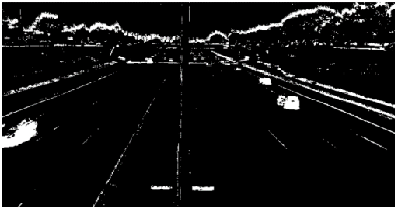
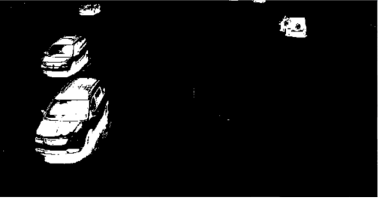
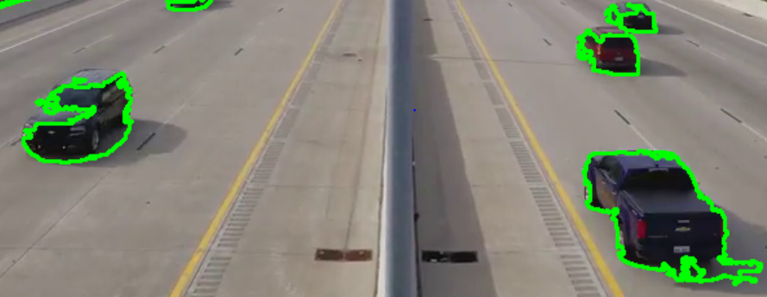

Detected Results:
Input video
Masking image of video before smoothening
Masking image of video after smoothing
Contour image
Final objection and tracking image

Slide 15
Pros and cons

Slide 16
Pros
In this model, a different “threshold” is selected for each pixel.
1
These pixel-wise “thresholds” are adapting by time.
2
Objects are allowed to become part of the background without destroying the existing background model
3
Provide fast recovery
4

Slide 17
cons
It cannot deal with sudden, drastic lightening changes.
Initializing the gaussians is important (median filtering)
There are many parameter and they should be selected intelligently

Slide 18

Thank you

